Slide 1

EasyRent An Angular-Based Car Rental Application
Sowjanya Kare (Team lead)
Shravya Bollabathini
Pavani Porandla
Nagalakshmi Pampana

Slide 2
Introduction:
EASYRENT is a web-based car rental application designed to simplify the process of renting vehicles.
Admin Management: Allows administrators to manage car listings, bookings, and user data efficiently.
Real-Time Updates: Reflects changes instantly using Angular’s reactive features
Secure Transactions: Facilitates secure login, registration, and payment processes.
User-Friendly Interface: Offers a responsive and intuitive UI for both users and admins.

Slide 3

Technology Stack
Layer - | Tools Used
Frontend - | Angular
HTTP Requests - | Angular HttpClientModule
Backend - | JSON Server
Testing - | Jasmine
Storage - | localStorage

Slide 4
Core Functionalities
Account Management: Register users, manage profiles, and store data securely(db.json)
Car Listings: Add, update, and remove cars via admin dashboard
Booking System: Validate availability, confirm bookings, and update status
Routing & Access: Role-based navigation for users and admins
History: Display all user actions, sorted by date

Slide 5
Application Modules
Booking & Car services Service – Handles data & logic
AdminComponent – manages car listings, user bookings, and system configurations
DashboardComponent – Displays user-specific data
HomeComponent – Landing page with introductory content and navigation
AvailableCars Component – Displays the present available cars

Slide 6
Key Features
User registration and data storage
Car browsing and Booking system
Admin panel for car listing and booking management
Modular routing for user and admin workflows
Persistent data with localStorage

Slide 7
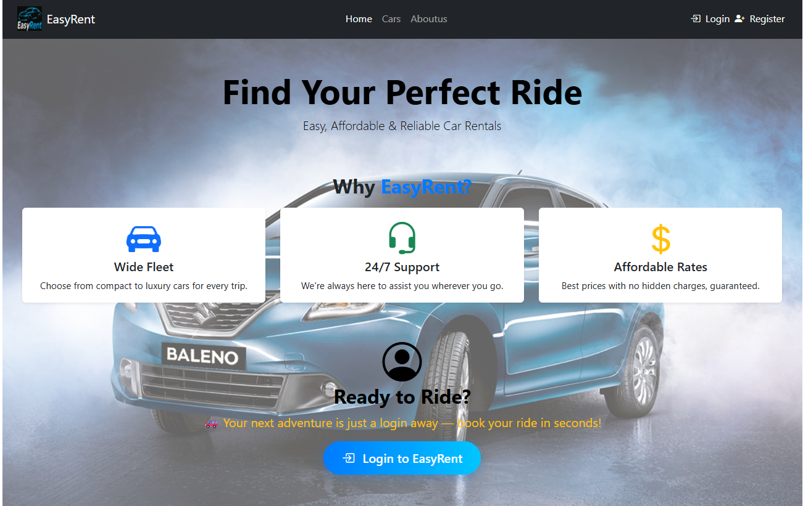
Landing Page

Slide 8
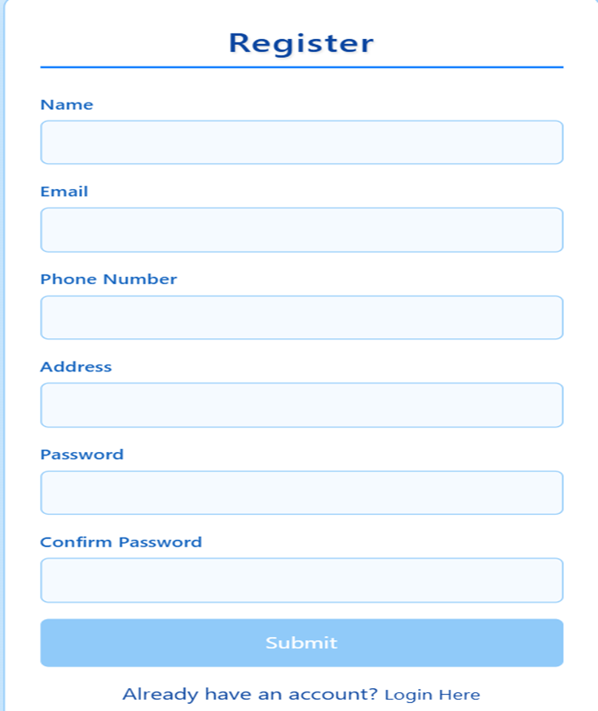
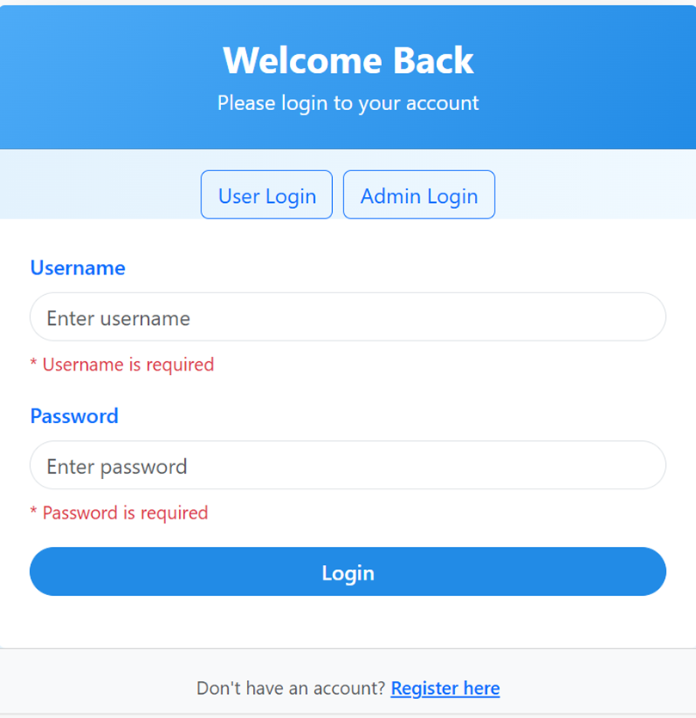
Register & Login page

Slide 9
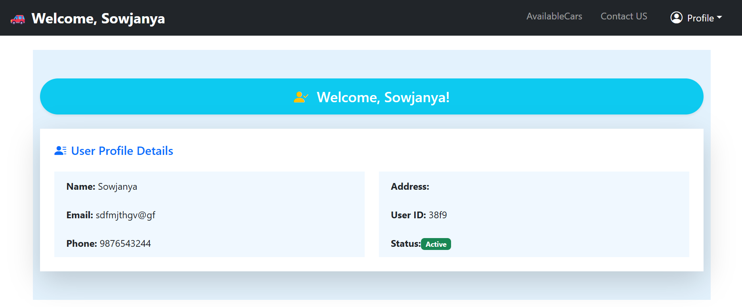
Dashboard

Slide 10
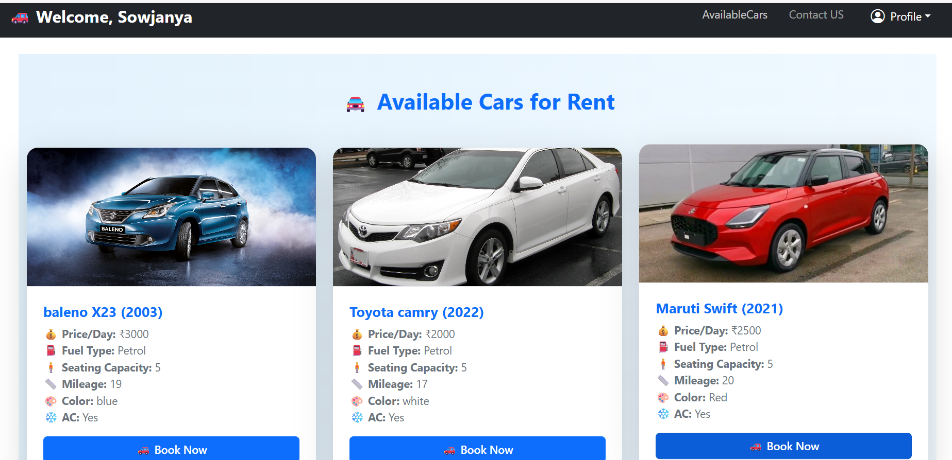

Slide 11
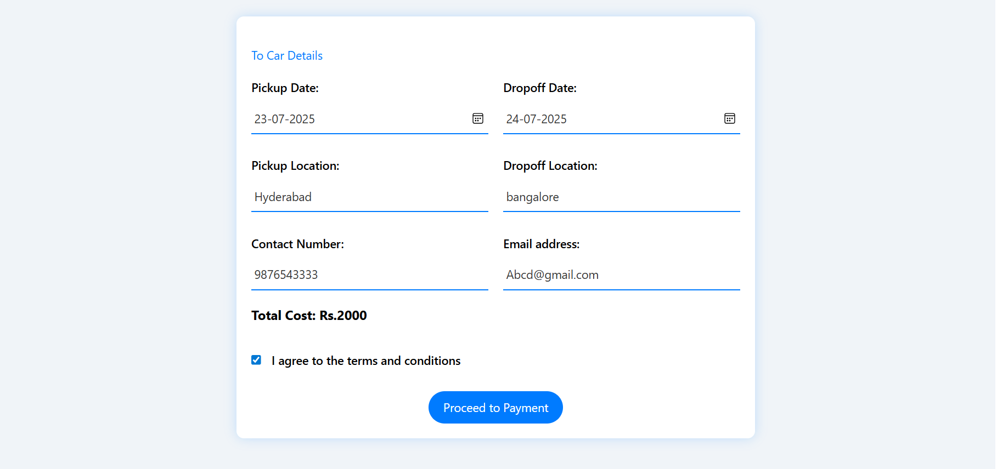
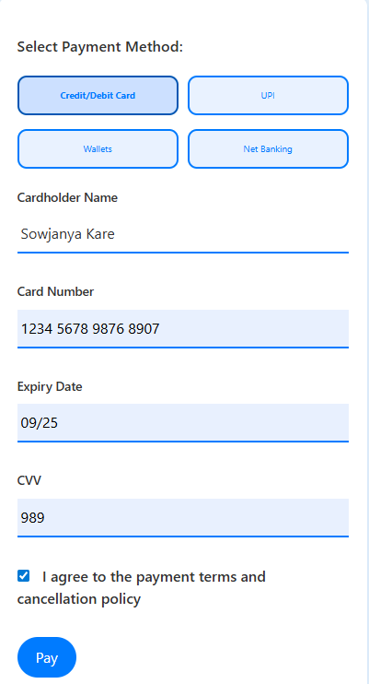
Payment Page

Slide 12
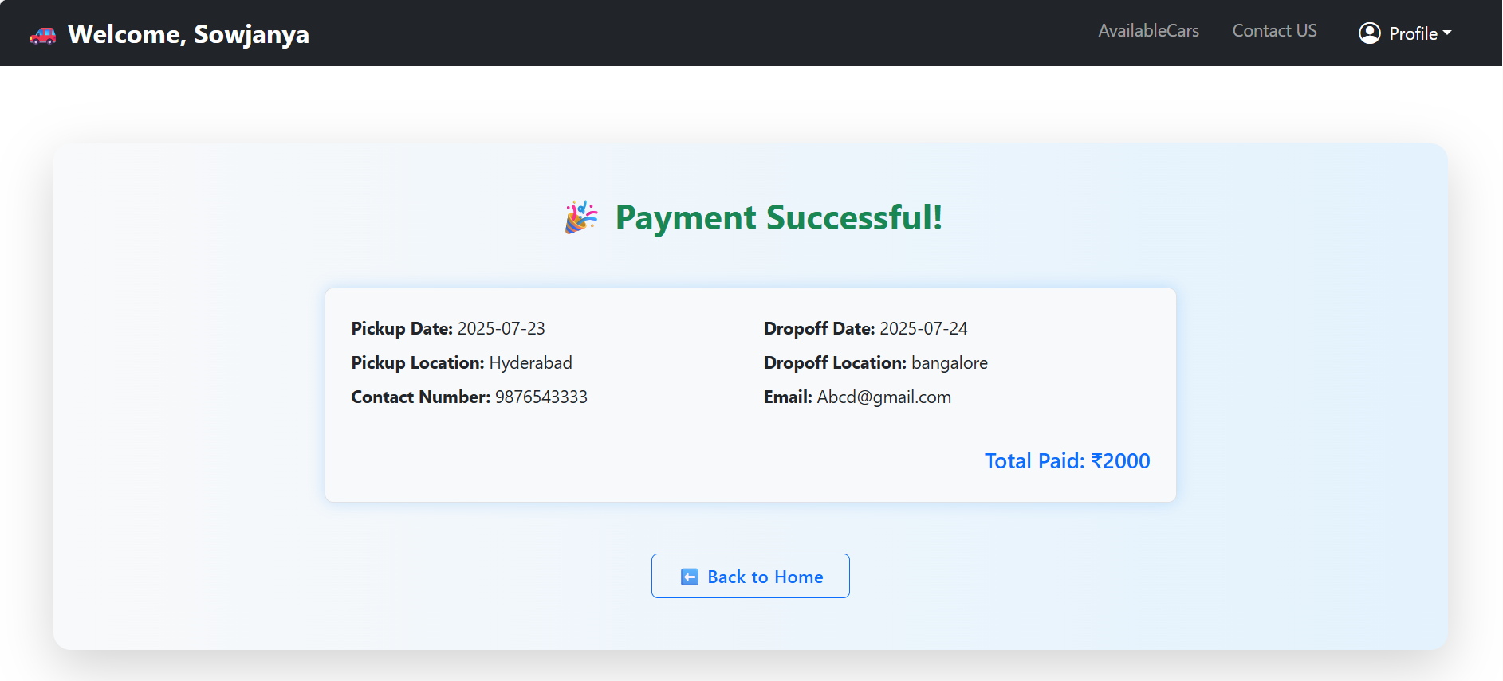
Payment Success page

Slide 13
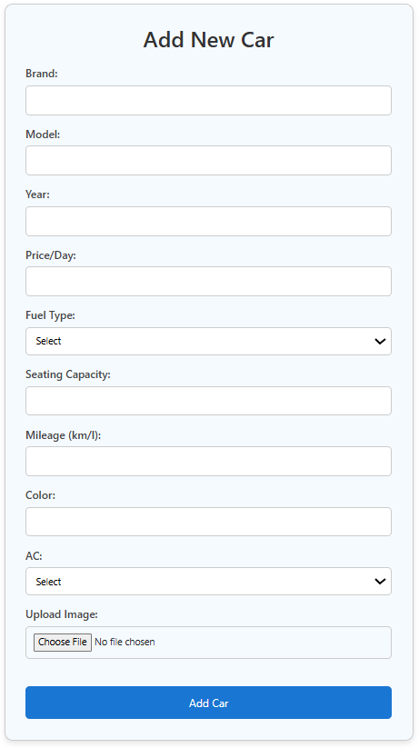
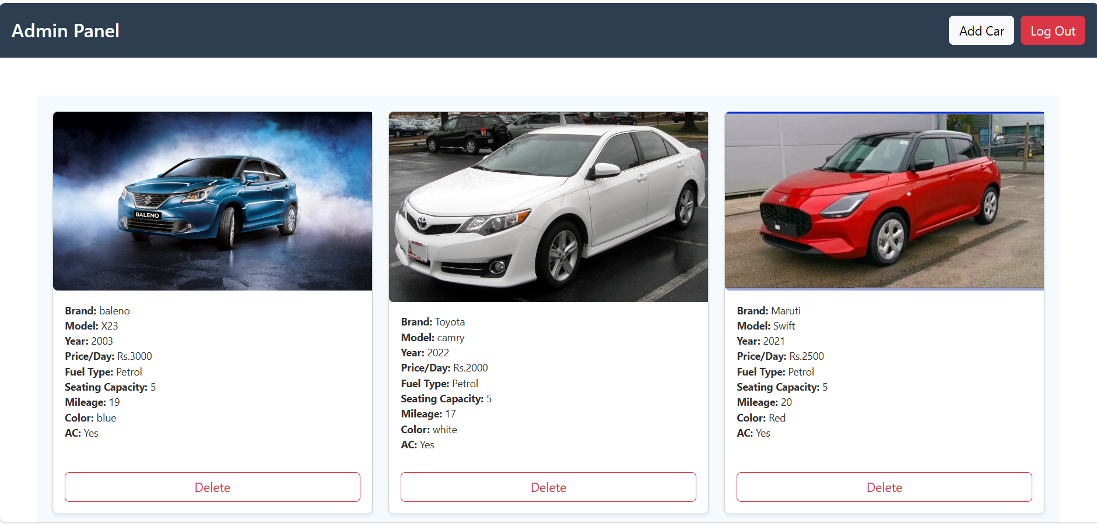
Admin Module

Slide 14
Backend Data Structure
{
"id": 1,
“name": Bob,
“email": 2421010,
“phone": 25900,
“password”:,
“address”:
}
User example
{
"id": 203,
“name": Alice,
“message":
}
Feedback example
{
"id": b700,
“brand": Toyota,
“model": Camry,
“year”: 2022,
“pricePerDay”: 3500
“fuelType”: Petrol,
“seatingCapacity”: 5,
“mileage”: 15,
“color”: White,
“ac”: Yes,
“image”: /car-image
}
Car example

Slide 15
Unit Testing
Test methods: AboutUs, ContactUs
Mock APIs with HttpClientTestingModule
Validate forms and component logic
Use spyOn() to track internals

Slide 16
Achievements
Real-time, dynamic data updates
Role-based access control for users and admins
Unit-tested and reliable
Scalable modern web architecture

Slide 17
Thank you ......

